Slide 1
Sascha Zieger

Slide 2








Platforms
Server
*
Desktop
Web
Android
iOS

Slide 3
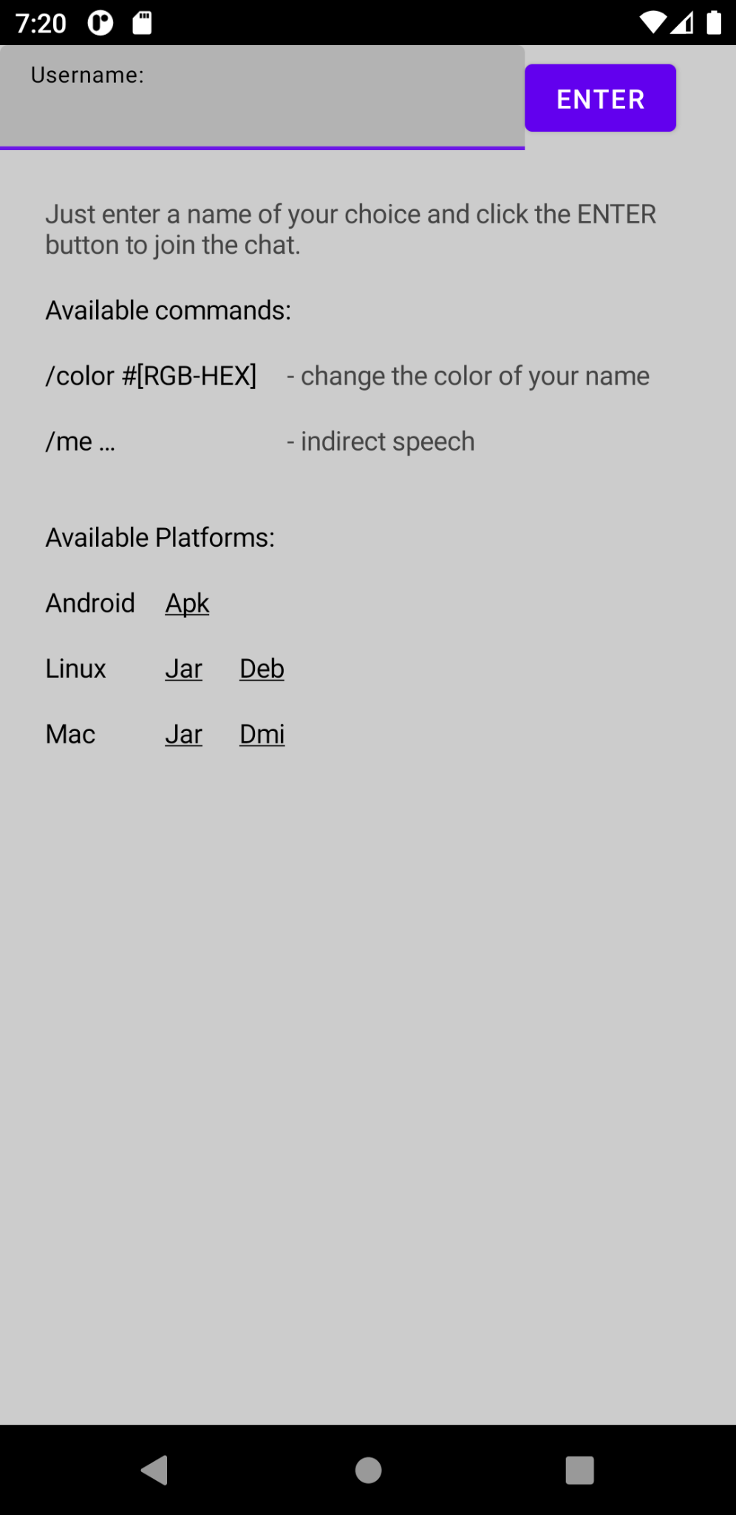
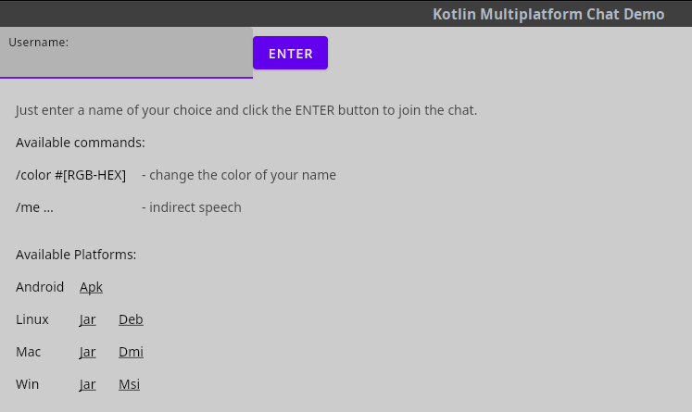
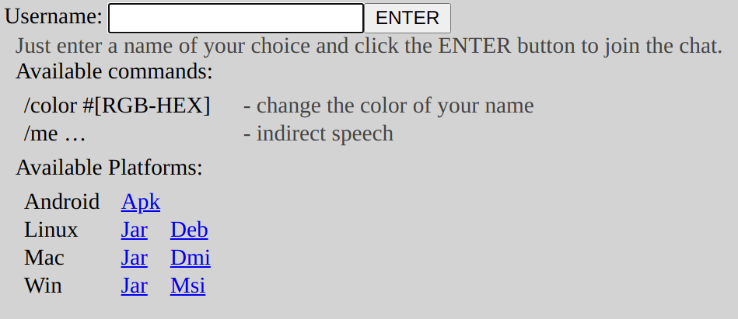
Apps

Slide 4
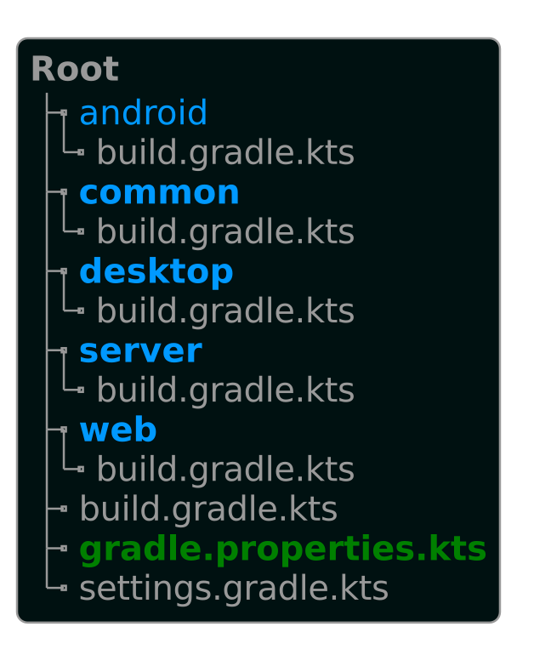
Project
Setup
minSdk=21
targetSdk=31
androidGradlePluginVersion=7.0.3
androidBuildToolsVersion=31.0.0
androidxAppCompatVersion=1.3.1
androidXActivityCompose=1.4.0
androidComposeVersion=1.1.0-alpha06
composeVersion=1.0.0-beta6-dev446
kotlinVersion=1.5.31
kotlinCoroutinesVersion=1.5.2
kotlinSerializationVersion=1.3.0
kotlinCssVersion=1.0.0-pre.221-kotlin-1.5.21
kotlinHtmlVersion=0.7.3
kotlin.js.webpack.major.version=4
ktorVersion=1.6.4
exposedVersion=0.35.1
xerialSqliteVersion=3.30.1
Notes:
ä

Slide 5
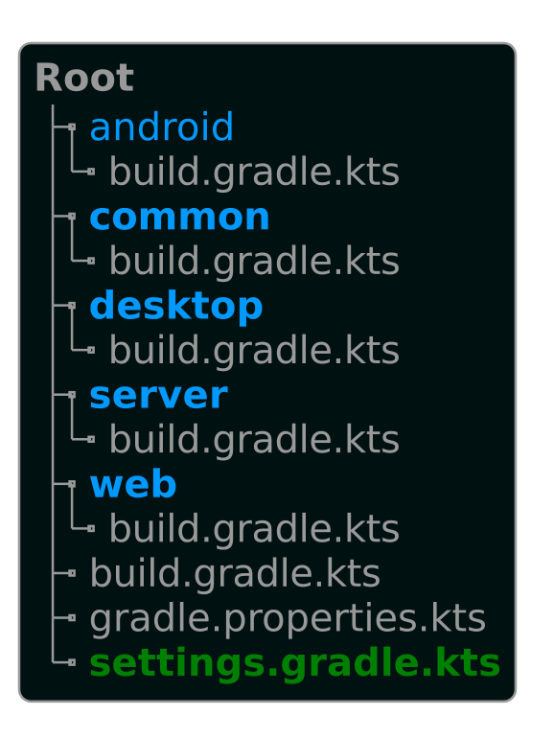
rootProject.name = "KotlinMpChatDemo"
include(":android:", ":common", ":desktop", ":server", ":web")
pluginManagement {
val kotlinVersion: String by settings
val composeVersion: String by settings
val androidGradlePluginVersion: String by settings
val shadowJarVersion: String by settings
plugins {
id("org.jetbrains.kotlin.jvm") version kotlinVersion
id("org.jetbrains.kotlin.kapt") version kotlinVersion
id("org.jetbrains.kotlin.multiplatform") version kotlinVersion
id("org.jetbrains.kotlin.plugin.serialization") version kotlinVersion
id("org.jetbrains.compose") version composeVersion
id("com.android.application") version androidGradlePluginVersion
id("com.github.johnrengelman.shadow") version shadowJarVersion
}
repositories {
gradlePluginPortal()
mavenCentral()
google()
}
resolutionStrategy {
eachPlugin {
when (requested.id.id) {
"com.android.application" -> {
useModule("${requested.id.id}:" +
"${requested.id.name}:$androidGradlePluginVersion"
)
}
}
}
}
}
Notes:
ä

Slide 6
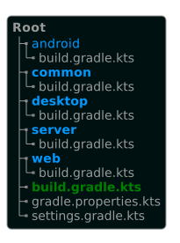
allprojects {
tasks.withType<KotlinCompile>() {
kotlinOptions.apply {
// OptIn Annotation
freeCompilerArgs = freeCompilerArgs + "-Xopt-in=kotlin.RequiresOptIn"
// Enable experimental APIs
freeCompilerArgs = freeCompilerArgs +
"-Xopt-in=kotlinx.coroutines.ExperimentalCoroutinesApi"
freeCompilerArgs = freeCompilerArgs + "-Xopt-in=kotlin.Experimental"
freeCompilerArgs = freeCompilerArgs +
"-Xopt-in=ExperimentalComposeWebWidgetsApi"
}
kotlinOptions.jvmTarget = "1.8"
}
repositories {
mavenLocal()
gradlePluginPortal()
google()
mavenCentral()
maven("https://jitpack.io")
maven("https://maven.pkg.jetbrains.space/public/p/compose/dev")
}
}
buildscript {
repositories {
gradlePluginPortal()
google()
mavenCentral()
maven("https://maven.pkg.jetbrains.space/public/p/compose/dev")
}
dependencies {
val kotlinVersion: String by project
classpath("org.jetbrains.kotlin:kotlin-gradle-plugin:$kotlinVersion")
classpath(kotlin("serialization", version = kotlinVersion))
val composeVersion: String by project
classpath("org.jetbrains.compose:compose-gradle-plugin:$composeVersion")
val androidGradlePluginVersion: String by project
classpath("com.android.tools.build:gradle:$androidGradlePluginVersion")
}
}
Notes:
ä

Slide 7
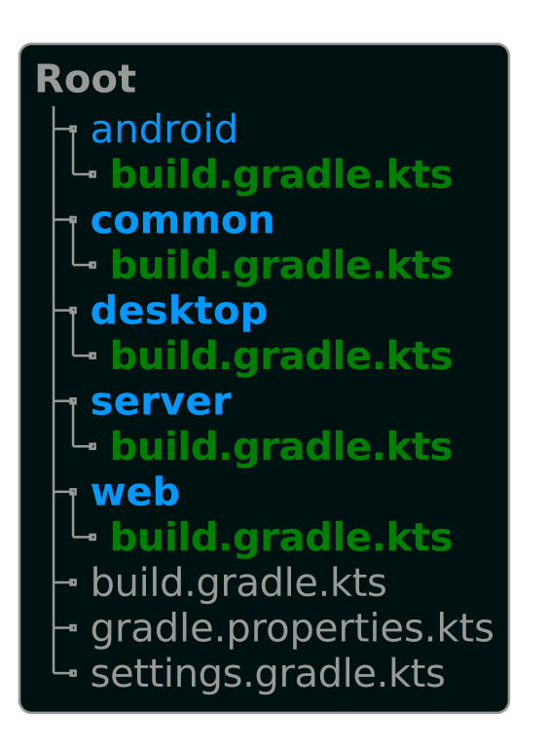
Project
Setup
plugins {
id("com.android.application")
kotlin("android")
kotlin("plugin.serialization")
id("org.jetbrains.compose")
}
plugins {
kotlin("multiplatform")
kotlin("plugin.serialization")
id("org.jetbrains.compose")
}
plugins {
kotlin("multiplatform")
kotlin("plugin.serialization")
id("org.jetbrains.compose")
}
plugins {
kotlin("multiplatform")
application
kotlin("plugin.serialization")
id("com.github.johnrengelman.shadow")
}
plugins {
kotlin("multiplatform")
kotlin("plugin.serialization")
id("org.jetbrains.compose")
}
Notes:
ä

Slide 8
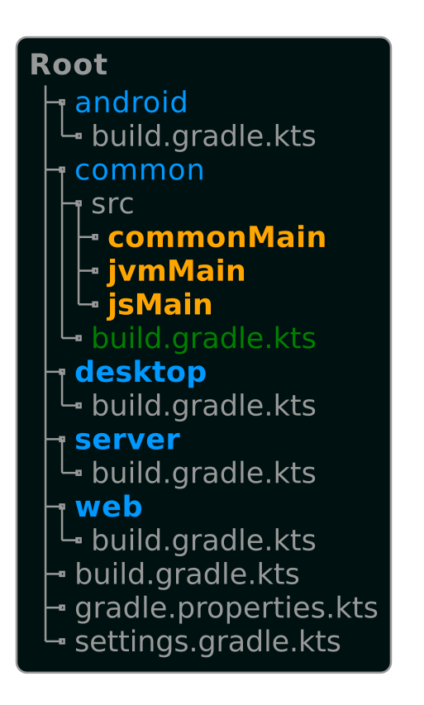
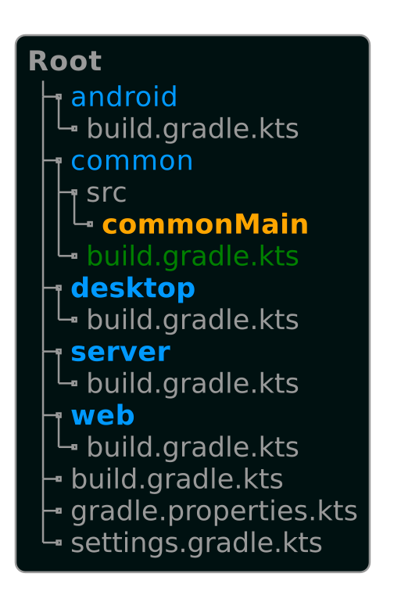
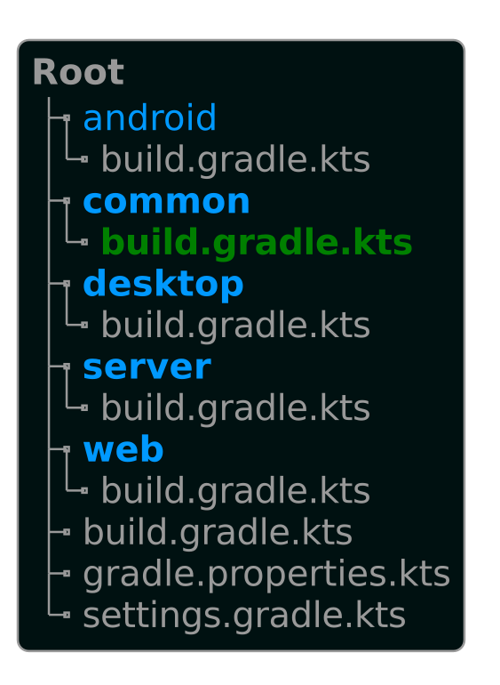
Project
Setup
val commonMain by getting {
dependencies {
implementation(kotlin("stdlib-common"))
implementation("org.jetbrains.kotlinx:
kotlinx-coroutines-core:
$kotlinCoroutinesVersion")
implementation("org.jetbrains.kotlinx:
kotlinx-serialization-json:1.3.0")
implementation("org.jetbrains.kotlinx:
kotlinx-html:0.7.2")
implementation("org.jetbrains.kotlin-
wrappers:kotlin-css:
1.0.0-pre.221-kotlin-1.5.21")
implementation(compose.web.widgets)
implementation(compose.runtime)
implementation("io.ktor:
ktor-client-websockets:$ktorVersion")
implementation("org.slf4j:slf4j-log4j12:
1.7.32")
}
}
val jvmMain by getting {
dependencies {
implementation(compose.desktop.currentOs)
implementation(compose.desktop.common)
implementation("org.slf4j:slf4j-log4j12:
1.7.32")
}
}
val jsMain by getting {
dependencies {
implementation(compose.web.core)
implementation(compose.runtime)
implementation("org.slf4j:slf4j-log4j12:
1.7.32")
}
}
kotlin {
jvm {
compilations.all {
kotlinOptions.jvmTarget = "15"
}
withJava()
}
js(IR) {
binaries.executable()
browser {
commonWebpackConfig {
cssSupport.enabled = true
}
}
}
sourceSets {
…
}
}
Notes:
ä

Slide 9
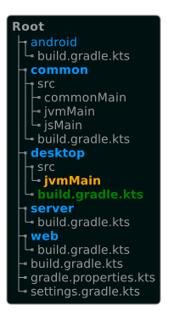
Project
Setup
kotlin {
jvm {
compilations.all {
kotlinOptions.jvmTarget = "15"
}
withJava()
}
sourceSets {
val jvmMain by getting {
dependencies {
implementation(project(":common"))
implementation(compose.desktop.currentOs)
implementation("io.ktor:ktor-client-cio:
$ktorVersion")
implementation("io.ktor:
ktor-client-websockets:$ktorVersion")
implementation("org.jetbrains.kotlinx:
kotlinx-coroutines-core:
$kotlinCoroutinesVersion")
implementation("org.jetbrains.kotlinx:
kotlinx-serialization-json:
$kotlinSerializationVersion")
implementation("org.slf4j:slf4j-log4j12:
1.7.32")
}
}
}
}
compose.desktop {
application {
mainClass =
"dev.zieger.mpchatdemo.desktop.
DesktopMainKt"
nativeDistributions {
packageVersion = "1.0.0"
targetFormats(Dmg, Msi, Deb)
}
}
}
Notes:
ä

Slide 10
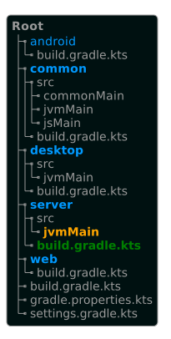
Project
Setup
tasks.named<Copy>("jvmProcessResources") {
val jsBrowserDistribution = rootProject.allprojects
.first {it.name == "web" }
.getAllTasks(true)
.flatMap { it.value.toList() }
.firstOrNull { it.name == "jsBrowserDistribution" }
dependsOn(jsBrowserDistribution)
from(jsBrowserDistribution)
}
tasks.named<JavaExec>("run") {
dependsOn(tasks.named<Copy>("jvmProcessResources"))
dependsOn(tasks.named<Jar>("jvmJar"))
classpath(tasks.named<Jar>("jvmJar"))
}
application {
mainClass.set("dev.zieger.mpchatdemo.server.ServerMainKt")
}
tasks {
named<ShadowJar>("shadowJar") {
archiveFileName.set("MpChatServerDemo.jar")
mergeServiceFiles()
manifest {
attributes(mapOf("Main-Class" to "dev.zieger.mpchatdemo.server.ServerMainKt"))
}
destinationDirectory.set(File(rootProject.projectDir.path))
}
}
kotlin {
jvm {
compilations.all {
kotlinOptions.jvmTarget = "1.8"
}
withJava()
}
sourceSets {
val jvmMain by getting {
dependencies {
implementation(project(":common"))
val ktorVersion: String by project
implementation("io.ktor:ktor-server-netty:
$ktorVersion")
implementation("io.ktor:ktor-websockets:
$ktorVersion")
implementation("io.ktor:ktor-html-builder:
$ktorVersion")
val kotlinCssVersion: String by project
implementation("org.jetbrains.kotlin-wrappers:
kotlin-css:$kotlinCssVersion")
val kotlinHtmlVersion: String by project
implementation("org.jetbrains.kotlinx:
kotlinx-html-jvm:$kotlinHtmlVersion")
val kotlinSerializationVersion: String
by project
implementation("org.jetbrains.kotlinx:
kotlinx-serialization-json:
$kotlinSerializationVersion")
val utilsVersion: String by project
implementation("dev.zieger.utils:time:
${utilsVersion}")
val exposedVersion: String by project
implementation("org.jetbrains.exposed:
exposed-core:$exposedVersion")
implementation("org.jetbrains.exposed:
exposed-dao:$exposedVersion")
implementation("org.jetbrains.exposed:
exposed-jdbc:$exposedVersion")
val xerialSqliteVersion: String by project
implementation("org.xerial:sqlite-jdbc:
$xerialSqliteVersion")
val slf4jVersion: String by project
implementation("org.slf4j:slf4j-log4j12:
$slf4jVersion")
}
}
}
}
Notes:
ä

Slide 11

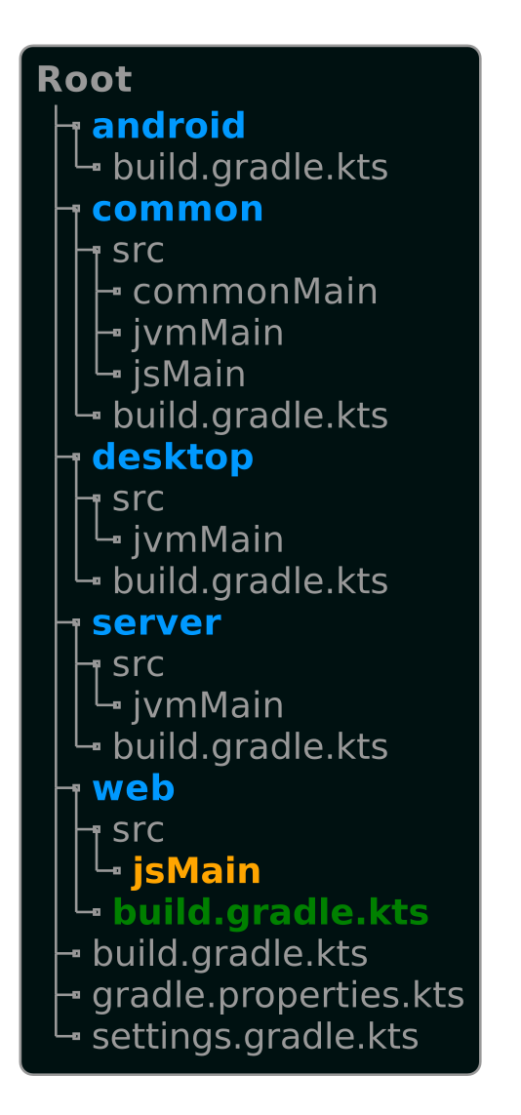
Kotlin Multiplatform
Chat-Demo
Project
Setup
￼
kotlin {
js(IR) {
binaries.executable()
browser()
}
sourceSets {
val jsMain by getting {
dependencies {
implementation(project(":common"))
implementation(compose.web.core)
implementation(compose.runtime)
val ktorVersion: String by project
implementation("io.ktor:ktor-client-websockets:
$ktorVersion")
val kotlinSerializationVersion: String
by project
implementation("org.jetbrains.kotlinx:
kotlinx-serialization-json:
$kotlinSerializationVersion")
val slf4jVersion: String by project
implementation("org.slf4j:slf4j-log4j12:
$slf4jVersion")
}
}
}
}
Notes:
ä

Slide 12
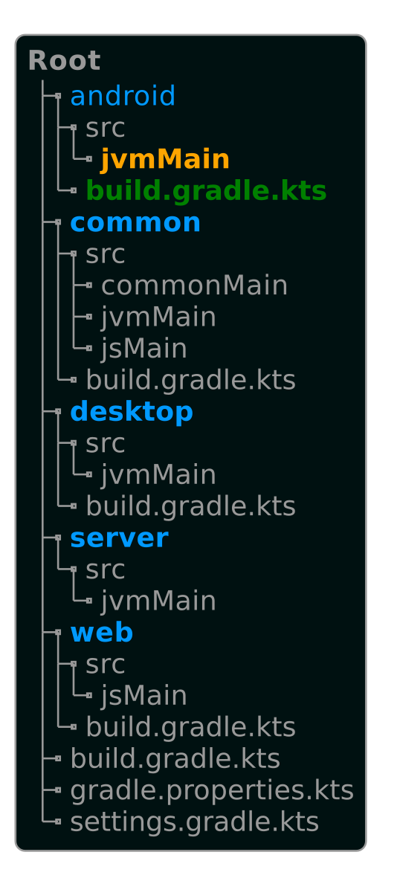
Project
Setup
dependencies {
implementation(project(":common"))
val kotlinCoroutinesVersion: String by project
implementation("org.jetbrains.kotlinx:
kotlinx-coroutines-core:$kotlinCoroutinesVersion")
val kotlinSerializationVersion: String by project
implementation("org.jetbrains.kotlinx:
kotlinx-serialization-json:$kotlinSerializationVersion")
val androidxAppCompatVersion: String by project
implementation("androidx.appcompat:
appcompat:$androidxAppCompatVersion")
val ktorVersion: String by project
implementation("io.ktor:ktor-client-okhttp:$ktorVersion")
implementation("io.ktor:ktor-client-websockets
:$ktorVersion")
implementation(compose.runtime)
implementation(compose.web.widgets)
implementation(compose.ui)
implementation(compose.foundation)
implementation(compose.material)
implementation(compose.materialIconsExtended)
val androidXActivityCompose: String by project
implementation("androidx.activity:
activity-compose:$androidXActivityCompose")
val slf4jVersion: String by project
implementation("org.slf4j:slf4j-log4j12:$slf4jVersion")
}
android {
…
buildFeatures {
compose = true
}
composeOptions {
val androidComposeVersion: String by project
kotlinCompilerExtensionVersion = androidComposeVersion
}
compileOptions {
sourceCompatibility = JavaVersion.VERSION_1_8
targetCompatibility = JavaVersion.VERSION_1_8
}
kotlinOptions {
jvmTarget = "1.8"
}
}
Notes:
ä

Slide 13
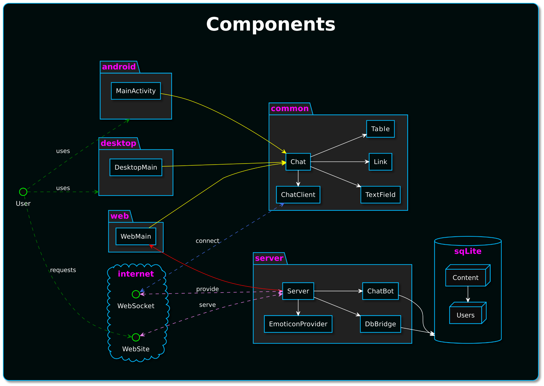

Slide 14
Server
fun HTML.rootHtml() {
head {
title("KotlinMpChatDemo")
link(rel = "stylesheet",
href = "/styles.css",
type = "text/css")
}
body {
div { id = "root" }
script(src = "/static/web.js") {}
}
}
fun CSSBuilder.rootCss() {
body {
backgroundColor = Color.lightGray
margin(5.px)
}
rule("root") {
width = 100.vw - 10.px
display = Display.flex
}
}
suspend fun start() {
embeddedServer(Netty, applicationEngineEnvironment {
connector {
host = this@Server.host
port = this@Server.port
}
module {
routing {
get("/") {
call.respondHtml(HttpStatusCode.OK,
HTML::rootHtml)
}
get("/styles.css") {
call.respondCss(CSSBuilder::rootCss)
}
static("/static") {
resources()
}
}
}
}).start(wait = true)
fun main(args: Array<String>) = runBlocking {
org.apache.log4j.BasicConfigurator.configure()
TimeStamp.DEFAULT_LOCALE = Locale.GERMANY
TimeStamp.DEFAULT_TIME_ZONE = TimeZone.getTimeZone(ZoneId.systemDefault())
val port = args.getOrNull(args.indexOf("-p") + 1)?.toIntOrNull()
?: Constants.INTERNAL_PORT
val path = args.getOrNull(args.indexOf("--path") + 1)
?: Constants.PATH
Server(Constants.INTERNAL_HOST, port, path).start()
}
setup WebServer
Notes:
// The routing block is invoked for all received http requests.
// Is invoked for all http calls to the root address. We will serve a HTML page
// with a root div tag that will be used by jetpack compose to render the content.
// Stylesheet file for the root HTML page.
// Serve all files from the resources folder. The build process will put the
// generated JavaScript of the web module inside here.
// This div tag will be used by jetpack compose to render our content.
// Generated JavaScript file of the web module. It is important, that this definition is
// called after the root div tag or jetpack compose will fail to start.

Slide 15
Server
embeddedServer(Netty, applicationEngineEnvironment {
…
module {
install(WebSockets) { pingPeriod = Duration.ofSeconds(60) }
val scope = CoroutineScope(Dispatchers.IO)
// This Channel will be used to send new ChatContent.
val firstStage = Channel<ChatContent>()
// store to and load from DB
val secondStage = DbMessageBridge(scope, firstStage)
// apply ChatBot
val thirdStage = ChatBot(scope, secondStage)
// replace emoticons
val finalStageChannel = Emoticons(scope, thirdStage)
// emit all values of the last Channel inside a new Flow
// and make this Flow a SharedFlow
val finalStageFlow = flow { emitAll(finalStageChannel) }
.shareIn(scope, SharingStarted.Eagerly, 128)
routing {
webSocket("/") {
handleClientConnection(scope,
finalStageFlow,
firstStage)
}
…
}
}).start(wait = true)
@Serializable
data class ChatContent(
val type: ChatContentType,
val user: ChatUser,
val key: Long,
val timestampFormatted: String,
val content: String,
val stored: Boolean = false
)
@Serializable
enum class ChatContentType { NOTIFICATION, MESSAGE, ME }
@Serializable
data class ChatUser(
val id: Long,
val name: String,
val color: Color
)
@Serializable
data class Color(val red: Int, val green: Int, val blue: Int) {
constructor() : this(
Random.nextInt(0, 255),
Random.nextInt(0, 255),
Random.nextInt(0, 255)
)
val color: Color
get() = Color(red, green, blue)
val argb: String = "#${red.hex}${green.hex}${blue.hex}"
}
embeddedServer(Netty, applicationEngineEnvironment {
…
module {
install(WebSockets) {
pingPeriod = Duration.ofSeconds(60)
}
routing {
webSocket("/") {
handleClientConnection(scope,
finalStageFlow,
firstStage)
}
…
}
}).start(wait = true)
abstract class ChatMessagePipe(
scope: CoroutineScope,
private val input: ReceiveChannel<ChatContent>,
output: Channel<ChatContent> = Channel()
) : ReceiveChannel<ChatContent> by output {
protected val output: SendChannel<ChatContent> = output
init {
scope.launch {
for (content in input)
onNewMessage(content)
}
}
abstract suspend fun onNewMessage(content: ChatContent)
}
setup WebSocket

Slide 16
Server
for (frame in incoming) when (frame) {
is Frame.Text -> {
Users.get(user.name)?.also {
frame.readText().ifBlank { null }?.also { msg ->
messageChannel.sendMessage(it, msg)
}
}
}
is Frame.Close -> {
Users.get(user.name)?.also {
messageChannel.sendNotification(it, "left chat")
}
}
is Frame.Ping,
is Frame.Pong -> Unit
else -> throw IllegalArgumentException(
"Unknown Frame type " + "${frame::class}"
)
}
sendJob.cancelAndJoin()
suspend fun DefaultWebSocketServerSession.handleClientConnection(
scope: CoroutineScope,
messages: Flow<ChatContent>,
messageChannel: Channel<ChatContent>
) {
call.parameters.getOrNull("username")?.also { u ->
val user = Users.getOrInsert(u)
val sendJob = scope.launch {
messages.collect {
send(json.encodeToString(ChatContent.serializer(), it))
}
}
messageChannel.sendNotification(user, "joined the chat")
handle WebSocket connection
routing {
websocket.
webSocket("/") {
handleClientConnection(scope,
finalStageFlow,
firstStage)
}
…
}

Slide 17
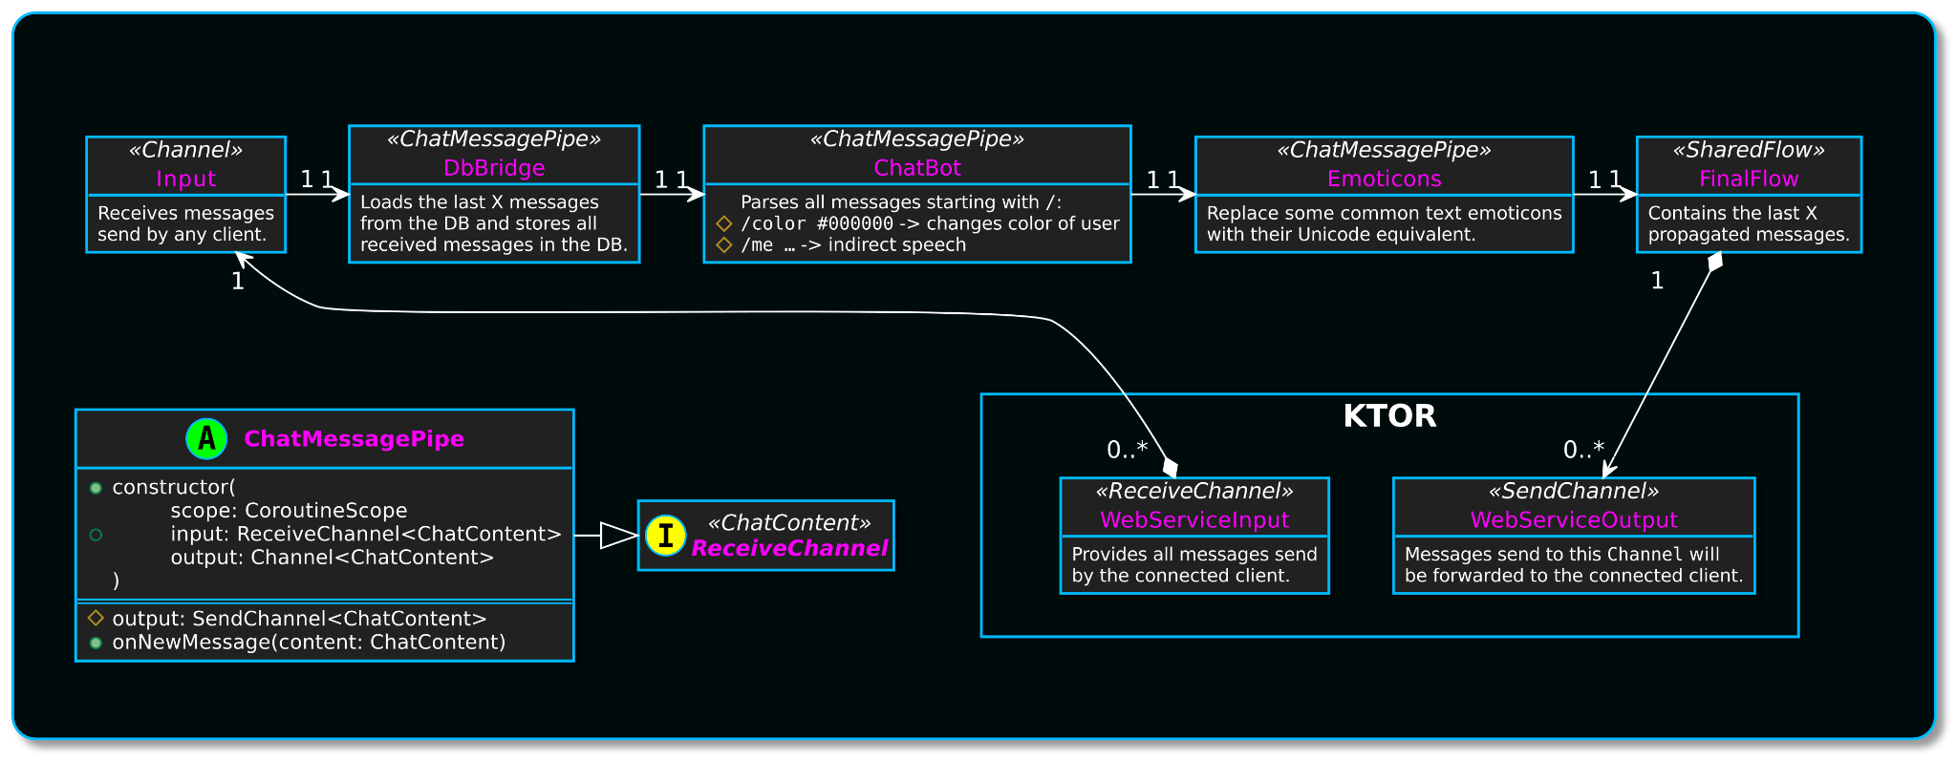
Message Pipeline

Slide 18
Pipelining vs Single Processing
A0
B0
A1
C0
B1
A2
D0
C1
B2
A3
E0
D1
C2
B3
A4
F0
E1
D2
C3
B4
A5
A4
A5
A0
A1
A3
A2

Slide 19
Server
class ChatBot(
scope: CoroutineScope,
input: ReceiveChannel<ChatContent>
) : ChatMessagePipe(scope, input) {
override suspend fun onNewMessage(content: ChatContent) {
if (!content.content.startsWith("/")) {
output.send(content)
return
}
handleColorChange(content)
?: handleIndirectSpeech(content)
?: run {
output.sendNotification(
content.user,
"invalid command: ${content.content}"
)
}
}
…
}
class Emoticons(
scope: CoroutineScope,
input: ReceiveChannel<ChatContent>
) : ChatMessagePipe(scope, input) {
companion object {
enum class Emoti(val raw: Pair<List<String>, String>) {
SMILE(listOf(":)", ":-)") to "\uD83D\uDE00"),
GREAT_SMILE(listOf(":D", ":-D") to "😁"),
WINKING(listOf(";)", ";-)") to "\uD83D\uDE09"),
UPSIDE_DOWN(listOf("(:", "(-:") to "\uD83D\uDE43"),
KISS(listOf(":*", ":-*") to "\uD83D\uDE18"),
HEART(listOf("<3") to "\uD83E\uDD70"),
TONGUE(listOf(":P", ":-P") to "\uD83D\uDE1B"),
EXPRESSION_LESS(listOf("-.-") to "\uD83D\uDE11"),
ROLLING_EYES(listOf("^.^") to "\uD83D\uDE44"),
CRYING(listOf(":'(") to "\uD83D\uDE25"),
SAD(listOf(":(", ":-(") to "☹")
}
}
override suspend fun onNewMessage(content: ChatContent) {
output.send(content.copy(content = Emoti.values().fold(content.content) { c, e ->
e.raw.first.fold(c) { c0, e0 -> c0.replace(e0, e.raw.second) }
}))
}
}
suspend fun handleColorChange(
c: ChatContent
) = """/color #([\dA-Fa-f]{2})([\dA-Fa-f]{2})([\dA-Fa-f]{2})""".toRegex()
.find(c.content)?.groupValues?.let { match ->
if (match.size == 4) {
Color(
match.getOrNull(1)?.toList()?.fromHexChar() ?: 0,
match.getOrNull(2)?.toList()?.fromHexChar() ?: 0,
match.getOrNull(3)?.toList()?.fromHexChar() ?: 0
)
} else null
}?.let { color ->
Users.setColorForUser(c.user, color).let { user ->
output.sendNotification(
user ?: c.user, when (user?.color == color) {
true -> "changed color to ${color.argb}"
false -> "change of color to ${color.argb} failed “ +
“(is ${user?.color?.argb})"
}
)
}
}
class DbMessageBridge(
scope: CoroutineScope,
input: ReceiveChannel<ChatContent>
) : ChatMessagePipe(scope, input) {
init {
scope.launch {
ChatContents.all().forEach {
output.send(it)
}
}
}
override suspend fun onNewMessage(content: ChatContent) {
ChatContents.add(content)
output.send(content.copy(stored = true))
}
}
Message Pipeline
suspend fun handleIndirectSpeech(
c: ChatContent
): Any? = """/me (.*)"""
.toRegex().find(c.content)?.groupValues?.getOrNull(1)?.also { msg ->
println("/me $msg")
output.sendMe(c.user, msg)
}

Slide 21
Server
object ChatContents : LongIdTable() {
val type = varchar("type", 32)
val user = reference("user", Users)
val key = long("key")
val timestampFormatted = varchar("timestamp", 128)
val content = varchar("content", 1024)
fun add(cc: ChatContent) {
transaction(db) {
insert {
it[type] = cc.type.name
it[user] = cc.user.id
it[key] = cc.key
it[timestampFormatted] = cc.timestampFormatted
it[content] = cc.content
}
}
}
fun all(): List<ChatContent> = transaction(db) {
ChatContentEntry.all()
.orderBy(key to SortOrder.ASC)
.map { it.chatContent }
.toList()
.takeLast(128)
}
}
object Users : LongIdTable() {
val name = varchar("name", 32)
val color = varchar("color", 8)
private fun add(userName: String, colorArgb: String): ChatUser = transaction {
insert {
it[name] = userName
it[color] = colorArgb
}.let { get(userName)!! } }
fun get(userName: String): ChatUser? = transaction {
UserEntry.find { name eq userName }.toList().firstOrNull()?.let {
it.chatUser
}
}
fun getOrInsert(userName: String): ChatUser =
get(userName) ?: add(userName, Color().argb)
fun setColorForUser(user: ChatUser, color: Color): ChatUser? = transaction {
UserEntry.find { name eq user.name }.toList().firstOrNull()?.let {
it.colorArgb = color.argb
}
}.let { get(user.name) }
}
class DbMessageBridge(
scope: CoroutineScope,
input: ReceiveChannel<ChatContent>
) : ChatMessagePipe(scope, input) {
init {
scope.launch {
ChatContents.all().forEach {
output.send(it)
}
}
}
override suspend fun onNewMessage(content: ChatContent) {
ChatContents.add(content)
output.send(content.copy(stored = true))
}
}
val db by lazy {
Database.connect(
"jdbc:sqlite:${File("./data.db").absolutePath}", "org.sqlite.JDBC"
).also {
TransactionManager.defaultDatabase = it
createTables()
}
}
private val TABLES = arrayOf(Users, ChatContents)
private fun createTables() {
transaction {
SchemaUtils.create(*TABLES)
}
}
class ChatContentEntry(entityID: EntityID<Long>) : LongEntity(entityID) {
companion object : LongEntityClass<ChatContentEntry>(ChatContents)
var type by ChatContents.type
var user: UserEntry by UserEntry referencedOn ChatContents.user
var key by ChatContents.key
var timestampFormatted by ChatContents.timestampFormatted
var content by ChatContents.content
val chatContent: ChatContent
get() = ChatContent(
ChatContentType.valueOf(type), user.chatUser, key,
timestampFormatted, content, true
)
}
class UserEntry(entityID: EntityID<Long>) : LongEntity(entityID) {
companion object : LongEntityClass<UserEntry>(Users)
var name by Users.name
var colorArgb by Users.color
val chatUser: ChatUser
get() = ChatUser(id.value, name, colorArgb.toColor())
}
DB

Slide 23
Common
@OptIn(ExperimentalComposeWebWidgetsApi::class)
@Composable
fun Chat(
host: String = "chat.zieger.dev",
port: Int = 443,
fontSize: Int = 25,
timeFontSize: Int = 15,
useDarkButtonColor: Boolean = false
) {
val model = remember { ChatModel() }
val errorState = remember { mutableStateOf<String?>(null) }
val chat = remember {
ChatClient(host, port, model.error, model.messages)
}
Column(modifier = Modifier.fillMaxWidth().fillMaxHeight(1f)
.background(Color.LightGray)) {
when {
errorState.value != null -> ShowError(errorState, model, useDarkButtonColor)
model.userName.value.isBlank() -> {
loggedOut(model, chat, useDarkButtonColor)
description()
}
model.isConnecting.value -> Text("connecting …")
else -> LoggedIn(model, chat, fontSize, timeFontSize, useDarkButtonColor)
}
}
}
Chat
data class ChatModel(
val userName: MutableState<String> = mutableStateOf(""),
val isConnecting: MutableState<Boolean> = mutableStateOf(false),
val userMessage: MutableState<String> = mutableStateOf(""),
val messages: SnapshotStateList<ChatContent> = mutableStateListOf()
)

Slide 24
Common
class ChatClient(
private val host: String,
private val port: Int,
private val errorState: MutableState<String?>,
private val messageList: SnapshotStateList<ChatContent>
) {
private val client = HttpClient {
install(WebSockets) {
pingInterval = WEB_SOCKET_PING_INTERVAL * 1000L
}
followRedirects = true
}
private val sendChannel = Channel<String>()
private val scope = CoroutineScope(Dispatchers.Default)
fun startSocket(username: String, onInitialized: () -> Unit): Job =
scope.launch {
initializeClient(username) {
onInitialized()
scope.launch { sendAll(sendChannel) }
receiveAll(messageList)
}
}
fun sendMessage(msg: String) {
scope.launch { sendChannel.send(msg) }
}
}
suspend fun initializeClient(
username: String,
session: suspend DefaultClientWebSocketSession.() -> Unit
) {
try {
when (host.contains("localhost")) {
false -> client.wss("/", request = {
host = this@ChatClient.host
port = this@ChatClient.port
parameter("username", username)
}, session)
true -> client.ws("/", request = {
host = this@ChatClient.host
port = this@ChatClient.port
parameter("username", username)
}, session)
}
} catch (t: Throwable) {
errorState.value = "$t"
}
}
suspend fun DefaultClientWebSocketSession.sendAll(
values: ReceiveChannel<String>) {
for (msg in values) send(msg)
}
suspend fun DefaultClientWebSocketSession.receiveAll(
messageList: SnapshotStateList<ChatContent>) {
for (frame in incoming) {
when (frame) {
is Frame.Text -> frame.readText().ifBlank { null }?.also {
messageList.add(Json.decodeFromString(it))
}
else -> Unit
}
}
}
ChatClient

Slide 25
Common
@Composable
fun loggedOut(
model: ChatModel,
chat: ChatClient,
useDarkButtonColor: Boolean
) = Row {
val scope = rememberCoroutineScope { Dispatchers.Default }
var focusRequester: () -> Unit = {}
TextField(
model.userName,
onValueChange = {
model.userName.value = it.filterNot { c -> c.isWhitespace() }
.ifBlank { null }?.take(32) ?: ""
},
maxLines = 1,
onSubmit = { login() },
focusRequester = { focusRequester = it },
label = { Text("Username: ") },
button = {
Button(onClick = { login() }) {
Text("ENTER", color = if (useDarkButtonColor) Color.Black
else Color.White)
}
}
)
DisposableEffect(Unit) {
focusRequester()
onDispose { }
}
}
@Composable
fun LoggedIn(
model: ChatModel,
chat: ChatClient,
fontSize: Int,
timeFontSize: Int,
useDarkButtonColor: Boolean
) {
var focusRequester: () -> Unit = {}
Row(
modifier = Modifier.fillMaxWidth(),
verticalAlignment = Alignment.CenterVertically
) {
TextField(
model.userMessage,
onValueChange = {
model.userMessage.value = it
},
onSubmit = { send() },
label = { Text("Message: ") },
button = {
Button(onClick = { send() }) {
Text("Send", color = if (useDarkButtonColor) Color.Black
else Color.White)
}
},
focusRequester = { focusRequester = it }
)
}
ChatMessageList(model.messages, fontSize.sp, timeFontSize.sp)
DisposableEffect(Unit) {
focusRequester()
onDispose { }
}
}
@Composable
private fun ChatContent.compose(
fontSize: TextUnit,
timeFontSize: TextUnit
) {
Box {
Row(
horizontalArrangement = Arrangement.Start,
verticalAlignment = Alignment.CenterVertically
) {
Text("[${timestampFormatted}] ", size = timeFontSize)
when (type) {
ChatContentType.NOTIFICATION -> {
Text("\"${user.name}\" ", size = fontSize, color =
user.color.color)
Text(content, size = fontSize)
}
ChatContentType.MESSAGE -> {
Text(user.name, size = fontSize, color =
user.color.color)
Text(": $content", size = fontSize)
}
ChatContentType.ME -> {
Text("${user.name} ", size = fontSize, color =
user.color.color)
Text(content, size = fontSize)
}
}
}
}
}
Column(modifier = Modifier
.fillMaxWidth()
.fillMaxHeight(1f)
.background(Color.LightGray)) {user.
when {
model.error.value != null ->
ShowError(model.error, model, useDarkButtonColor)
model.userName.value.isBlank() -> {
loggedOut(model, chat, useDarkButtonColor)
description()
}
model.isConnecting.value -> Text("connecting …")
else -> LoggedIn(model, chat, fontSize, timeFontSize,
useDarkButtonColor)
}
}
fun ShowError(
errorState: MutableState<String?>,
model: ChatModel,
useDarkButtonColor: Boolean
) {
Text(errorState.value!!)
Button(onClick = {
model.userName.value = ""
errorState.value = null
}) { Text("retry", color = if (useDarkButtonColor) Color.Black
else Color.White) }
}
@Composable
fun ChatMessageList(
messages: SnapshotStateList<ChatContent>,
fontSize: TextUnit,
timeFontSize: TextUnit
) {
Column(modifier = Modifier.fillMaxWidth()) {
messages.forEach { it.compose(fontSize, timeFontSize) }
}
}
Chat
fun login() {
model.isConnecting.value = true
model.userName.value = userName.value
scope.launch {
chat.startSocket(model.userName.value) {
model.isConnecting.value = false
}
}
}
fun send() {
chat.sendMessage(model.userMessage.value)
model.userMessage.value = ""
}

Slide 27
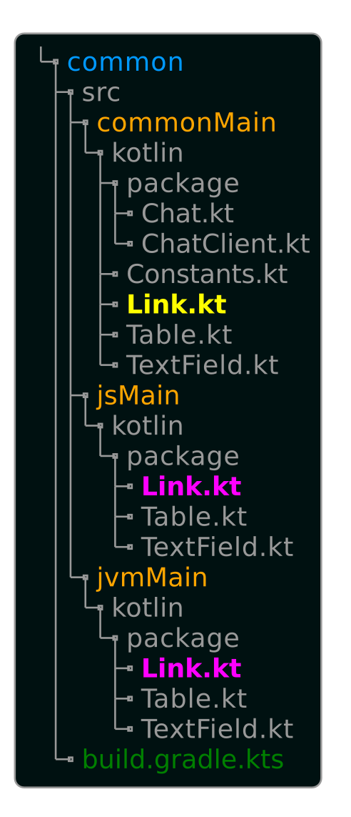
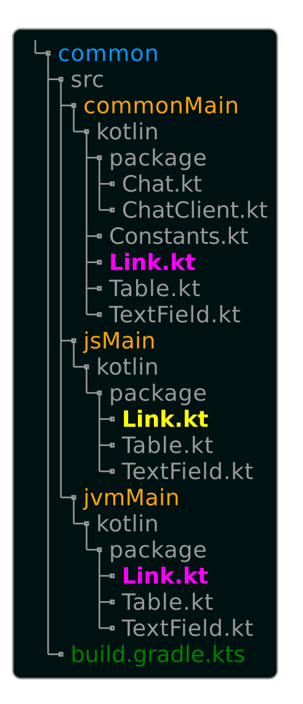
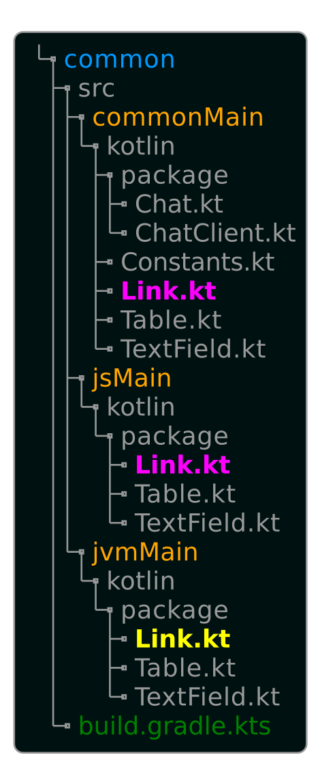
Link
@Composable
expect fun Link(url: String, content: String)
@Composable
actual fun Link(url: String, content: String) {
A(url) { Text(content) }
}
@Composable
actual fun Link(url: String, content: String) {
val urlToOpen = remember {
mutableStateOf<String?>(null)
}
Text(content,
modifier = Modifier
.clickable { urlToOpen.value = url }
.padding(8.dp),
textDecoration = TextDecoration.
Underline)
urlToOpen.value?.also {
LocalUriHandler.current.openUri(it)
urlToOpen.value = null
}
}

Slide 28
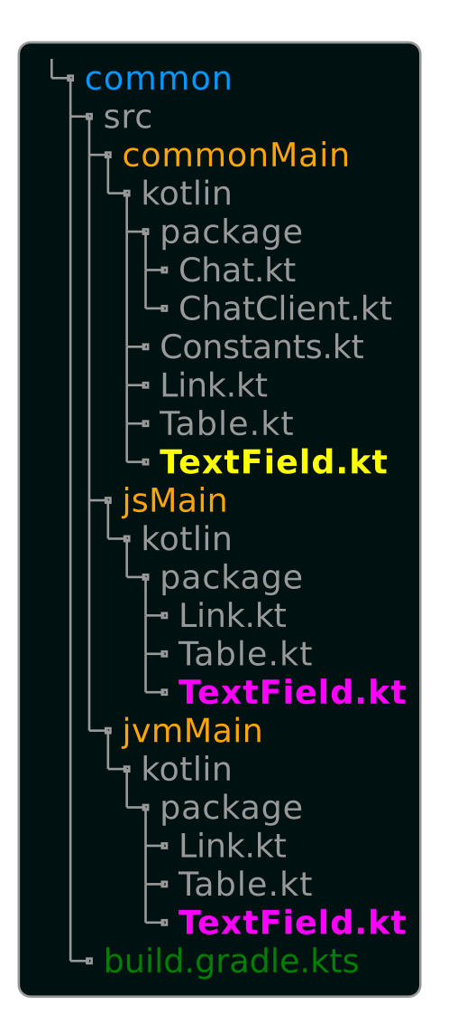
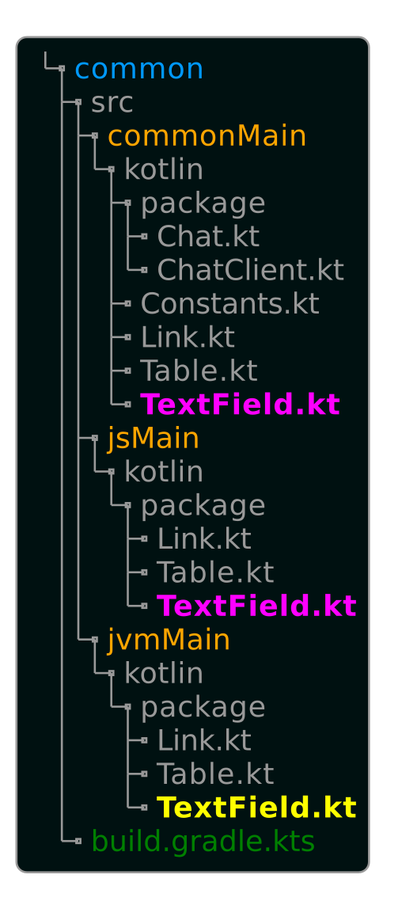
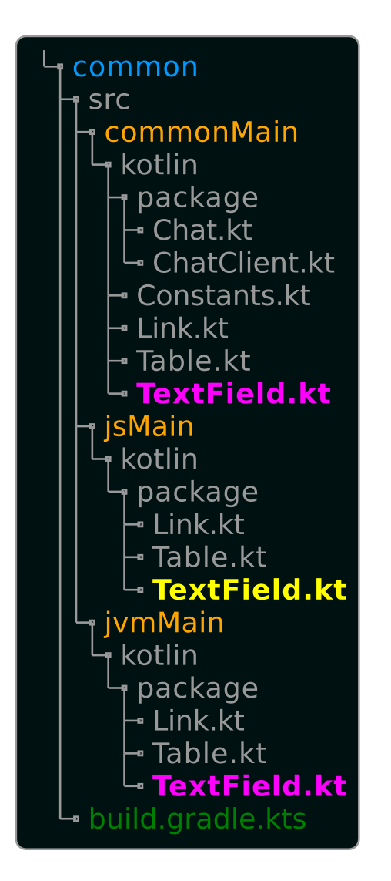
TextField
@Composable
actual fun TextField(
content: State<String>,
onValueChange: (String) -> Unit,
label: @Composable () -> Unit,
button: @Composable () -> Unit,
maxLines: Int?,
// not implemented for JS
focusRequester: (() -> Unit) -> Unit, onSubmit: () -> Unit
) {
Row(horizontalArrangement = Arrangement.Start,
verticalAlignment =
Alignment.CenterVertically) {
label()
TextInput(content.value) {
autoFocus()
onInput {
val text = it.value
if (text.last() == '\n') onSubmit()
else onValueChange(text)
}
onKeyDown { if (it.key == "Enter")
onSubmit()
}
}
button()
}
}
@Composable
actual fun TextField(
…
) {
Row(
horizontalArrangement = Arrangement.Start,
verticalAlignment = Alignment.CenterVertically
) {
androidx.compose.material.TextField(
content.value, {
if (it.last() == '\n') onSubmit()
else onValueChange(it)
},
label = { label() },
keyboardOptions = KeyboardOptions.Default
.copy(imeAction = ImeAction.Done),
keyboardActions = KeyboardActions(
onDone = { onSubmit() }),
singleLine = maxLines == 1,
maxLines = maxLines ?: Int.MAX_VALUE,
modifier = Modifier
.focusRequester(FocusRequester().also { req ->
focusRequester { req.requestFocus() }
}).onKeyEvent {
if (it.key == Key.Enter) {
onSubmit()
true
} else false
}
)
button()
}
}
@Composable
expect fun TextField(
content: State<String>,
onValueChange: (String) -> Unit,
label: @Composable () -> Unit = {},
button: @Composable () -> Unit = {},
maxLines: Int? = null,
focusRequester: (() -> Unit) -> Unit = {},
onSubmit: () -> Unit = {}
)

Slide 29
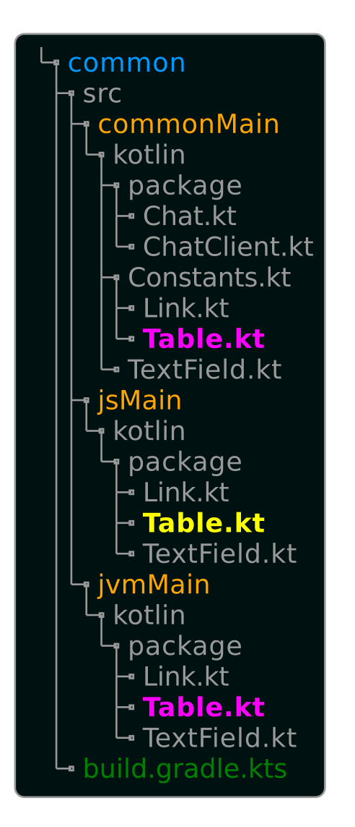
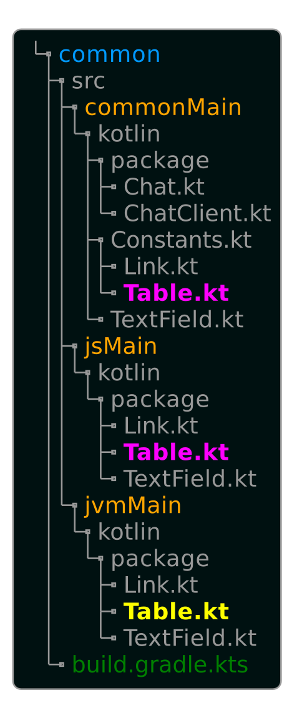
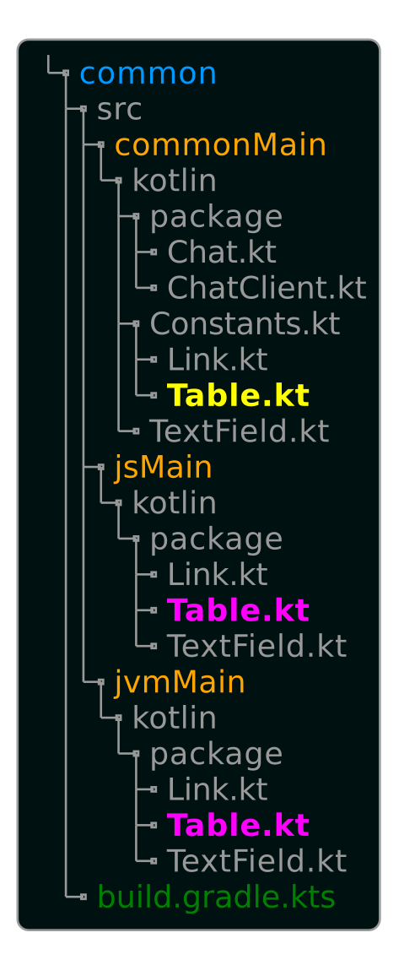
Table
@Composable
actual fun Table(modifier: Modifier,
block: @Composable
TableScope.() -> Unit) {
org.jetbrains.compose.web.dom.Table {
Row(modifier) {
TableScope().block()
}
}
}
actual class TableScope {
@Composable
actual fun Tr(block: @Composable
(TableScope.() -> Unit)) {
org.jetbrains.compose.web.dom
.Tr(null) { block() }
}
@Composable
actual fun Td(block: @Composable
(TableScope.() -> Unit)) {
org.jetbrains.compose.web.dom
.Td(null) { block() }
}
}
Text(
"Available commands:", color = Color.Black,
modifier = Modifier.padding(8.dp)
)
Table(Modifier.padding(24.dp)) {
Tr {
Td {
Tr {
Text(
"/color #[RGB-HEX]",
modifier =
Modifier.padding(8.dp),
color = Color.Black
)
}
Tr {
Text(
"/me …",
modifier =
Modifier.padding(8.dp),
color = Color.Black
)
}
}
@Composable
actual fun Table(modifier: Modifier, block: @Composable TableScope.() -> Unit) {
TableScope().block()
}
actual class TableScope {
@ExperimentalComposeWebWidgetsApi
@Composable
actual fun Tr(block: @Composable
TableScope.() -> Unit) {
Row { block() }
}
@ExperimentalComposeWebWidgetsApi
@Composable
actual fun Td(block: @Composable
TableScope.() -> Unit) {
Column { block() }
}
}
Td {
Tr {
Text(
"- change the color of your name",
color = Color.DarkGray,
modifier = Modifier.padding(8.dp)
)
}
Tr {
Text(
"- indirect speech",
color = Color.DarkGray,
modifier = Modifier.padding(8.dp)
)
}
}
}
}
@Composable
expect fun Table(modifier: Modifier,
block: @Composable TableScope.() -> Unit)
expect class TableScope {
@Composable
fun Tr(block: @Composable (TableScope.() -> Unit))
@Composable
fun Td(block: @Composable (TableScope.() -> Unit))
}

Slide 31
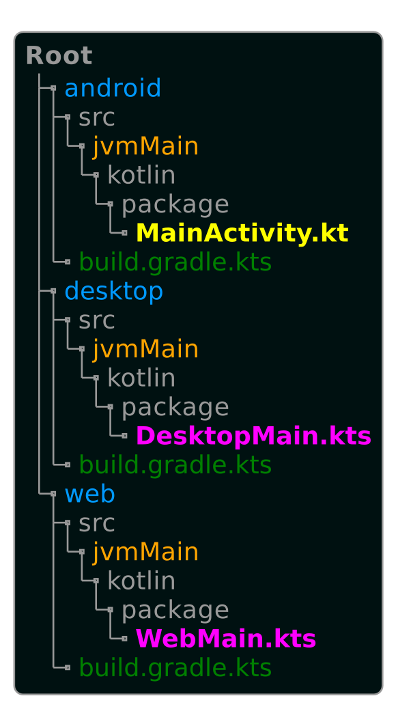
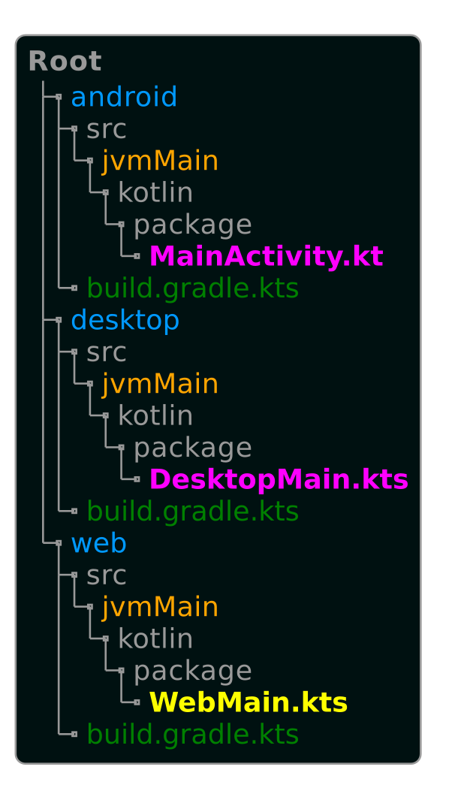
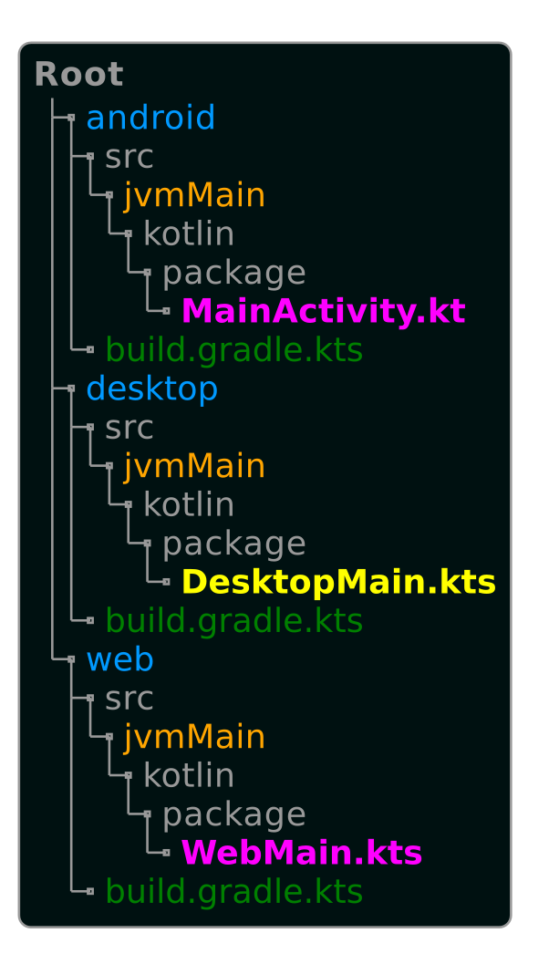
Entrypoints
fun main(args: Array<String>) = runBlocking {
org.apache.log4j.BasicConfigurator.configure()
singleWindowApplication(
state = WindowState(
size = DpSize(1200.dp, 800.dp)),
title = "Kotlin Multiplatform Chat Demo"
) {
val host = args.getOrNull(args
.indexOf("-h") + 1) ?:
Constants.EXTERNAL_HOST
val port = args.getOrNull(args.
indexOf("-p") + 1)
?.toIntOrNull() ?:
Constants.EXTERNAL_PORT
Chat(host, port)
}
}
fun main() {
renderComposable(rootElementId = "root") {
val url = Url(document.URL)
val isLocal = url.host.contains("localhost")
Chat(
url.host, when (isLocal) {
true -> 9024
false -> url.port
},
useDarkButtonColor = true
)
}
}
class MainActivity : ComponentActivity() {
override fun onCreate(
savedInstanceState: Bundle?) {
super.onCreate(savedInstanceState)
org.apache.log4j.BasicConfigurator.configure()
setContent {
Chat()
}
}
}

Slide 32
Deployment
build artifacts
Linux Deb and Jar
Mac Dmi and Jar
Windows Msi and Jar
Android Apk
upload artifacts to server
let server pull, rebuild and start latest version
update readme
=> GitHub Actions

Slide 33
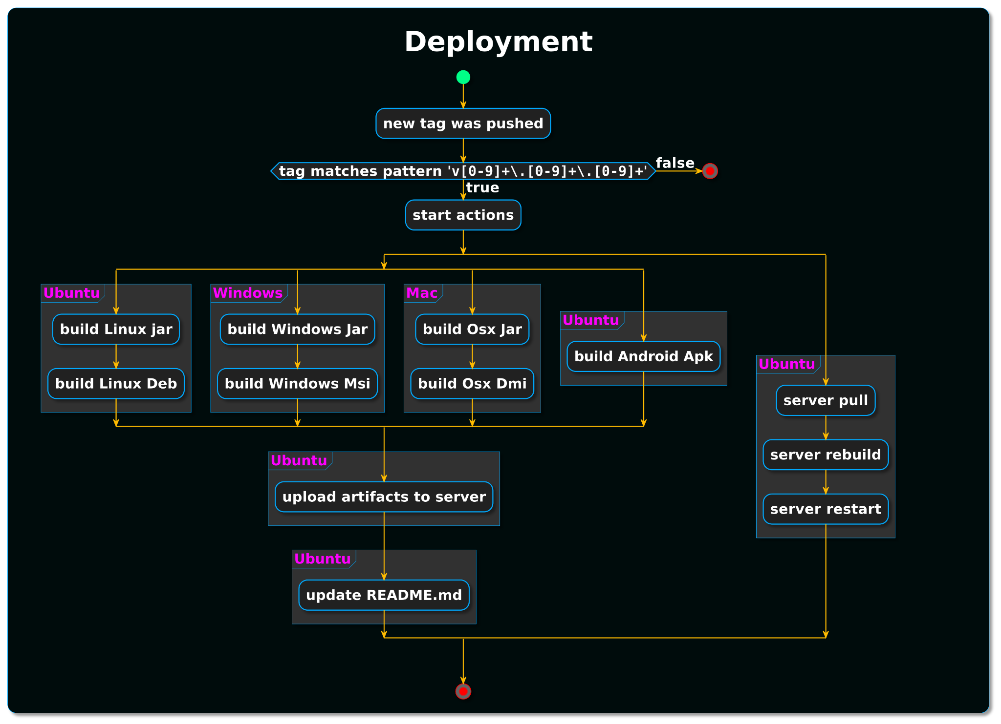

Slide 34
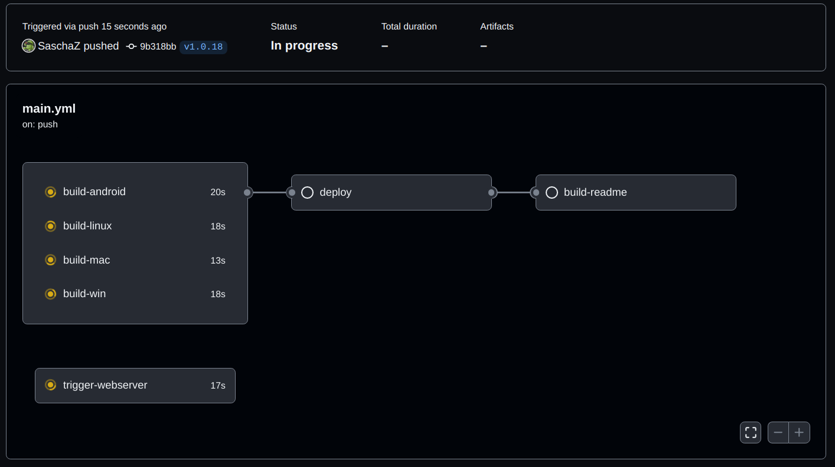

Slide 35
GitHub Actions
- uses: actions/checkout@v2
- uses: actions/setup-java@v1
with:
java-version: 15
- name: Setup Android SDK
uses: android-actions/setup-android@v2
- name: Set output
id: vars
run: echo ::set-output name=tag::${GITHUB_REF#refs/*/}
- name: Build with Gradle
run: ./applyTag.sh ${{ steps.vars.outputs.tag }} &&
./assembleApk.sh${{secrets.ANDROID_KEY_PASSWORD}}
- name: Cache artifacts
uses: actions/cache@v2
with:
path: ./MpChatDemoAndroid/MpChatDemo/
${{ steps.vars.outputs.tag
key: android-${{ steps.vars.outputs.tag }}
- name: Prepare Release
run: |
mkdir -p ./MpChatDemoAndroid/MpChatDemo/${{ steps.vars.outputs.tag }}
cp ./MpChatAndroidDemo.apk ./MpChatDemoAndroid/MpChatDemo/${{ steps.vars.outputs.tag }}/MpChatDemo-android-${{ steps.vars.outputs.tag }}.apk
name: MpChatDemo CI
on:
push:
tags:
- 'v*.*.*'
jobs:
build-android:
runs-on: ubuntu-latest
steps:
…
yaml

Slide 36
Open Questions
How to have an Android specific source set in the common module?
Overview of available Composables for Android, Desktop and Web

Slide 37
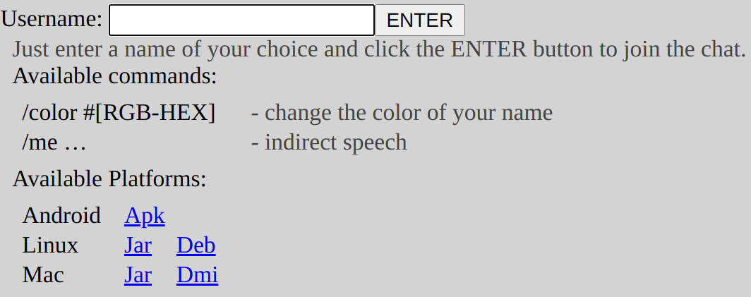
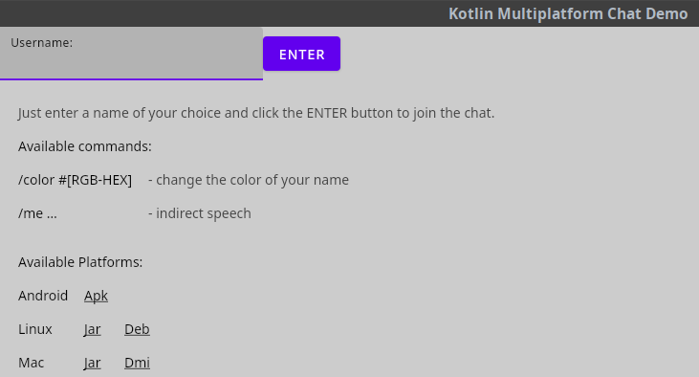
chat.zieger.dev

